Slide 1
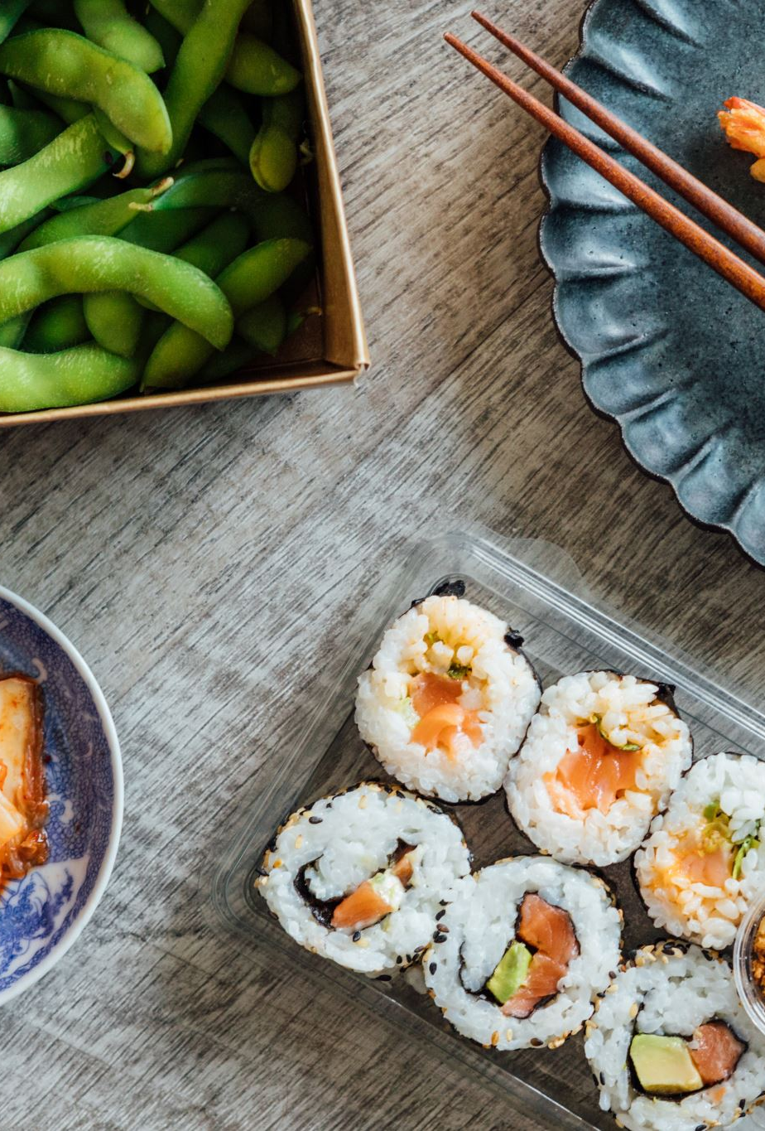
Business analysis of Jakarta food and drinks
Rabbi Islam Yeasin
Engineer of Computer Science
IBM Certified Professional Data Scientist
Data Science Intern , InternInfoTech
Ex Machine Learning Intern, MentorNess

Slide 2
Case Study
This dataset contains Food and Beverage Service Business Data Types of Restaurant Businesses in DKI Jakarta Explanation of the Variables in this Dataset: 1. business_name : restaurant business name in DKI Jakarta 2. business_address : restaurant business address 3. business_corporation : business entity name 4. person in charge : name of person in charge or name of restaurant owner 5. region : Name of Region in DKI Jakarta Province 6. telephone no. : telephone number of the restaurant business 7. no_fax : Fax number of the restaurant business 8. business_type : name of the type of business 9. capacity : capacity of the restaurant
Dataset of Jakarta Food and Drinks Culinary Business 2014

Slide 3
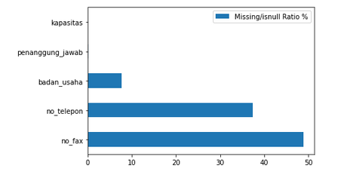
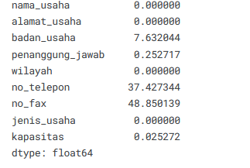
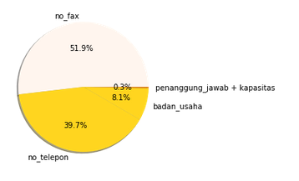

Dataset Study
Missing Value Ratio
Missing Value Percentage
Missing Value Plot in Pie Chart

Slide 4
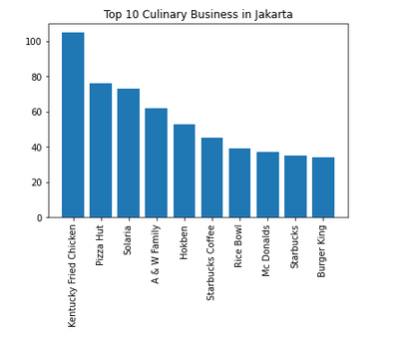
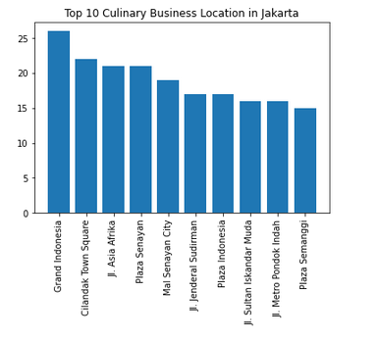
Top culinary Business in Jakarta
Insight-
Kentucky Fried Chicken (KFC) is the most popular franchise business in Jakarta
Grand Indonesia is popular location for franchise business in Jakarta

Slide 5
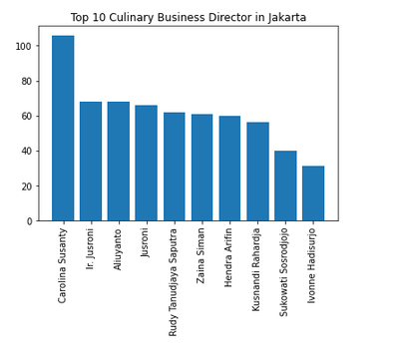
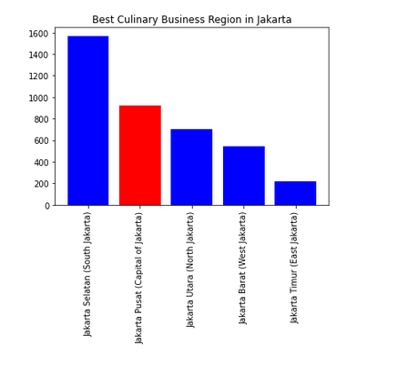
Top Directors and Business Regions for Culinary
Insight-
Carolina Susanty is the most popular culinary business and franchise director in Jakarta
South Jakarta is the most popular city/region for culinary and franchise business in Jakarta surpassing the Central Jakarta as national capital of Indonesia

Slide 6
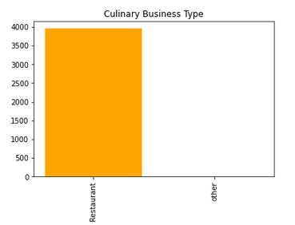
Popular Business Type (Cafe/Restaurant/Others)
Which Culinary Business and Franchise is popular in Jakarta?
What kind of room capacity is commonly used for culinary business in Jakarta?
Insights
10/40/B is the most popular room capacity for culinary and franchise business in Jakarta
Insight-
Restaurant is the most popular type of business and franchise in Jakarta

Slide 7
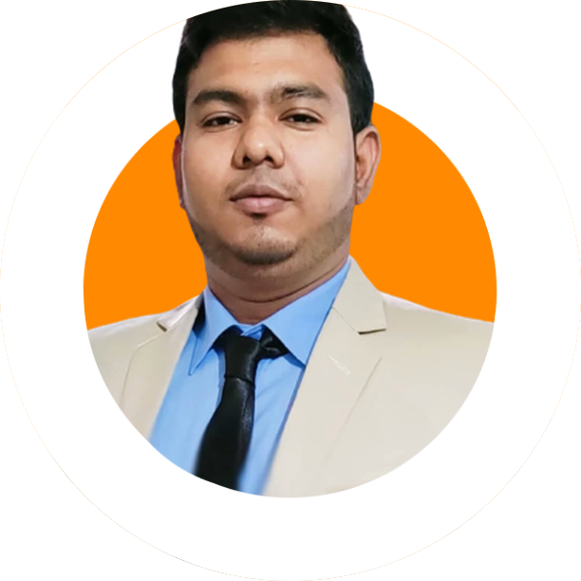




Thank You
Rabbi Islam Yeasin
Engineer of Computer Science
IBM Certified Professional Data Scientist
Data Science Intern , InternInfoTech
Ex Machine Learning Intern, MentorNess

